Slide 1
Name: _______________________ Date:___________________
are
Lions
have
can
___________________________Word Bank__________________________________
predators.
fur.
roar.

Slide 2
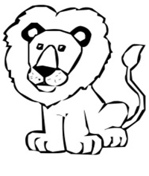
can | Lions | ROAR!
can | Lions | ROAR!
can | Lions | ROAR!
can | Lions | ROAR!

Slide 3
Name: _______________________________________ Date: _________________
Main Idea:
Details:

