Slide 1
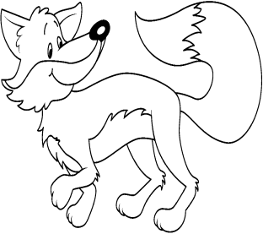
Foxes
Name: ________________________________
Foxes are mammals.
They are nocturnal.
Foxes eat birds, rabbits and other small prey.
Foxes live in dens.
What are foxes?
What do foxes eat?
Where do foxes live?

